Slide 1
Single-Source Shortest Path Algorithm
Md. Muktar Hossain
Lecturer
Dept. of CSE
Varendra university

Slide 2
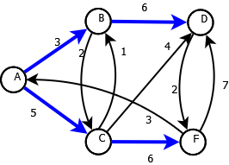
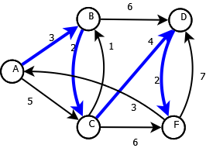
Single-Source Shortest Path Problem
Single-Source Shortest Path Problem - The problem of finding shortest paths from a source vertex v to all other vertices in the graph.

Slide 3
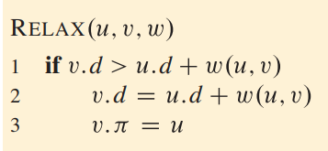
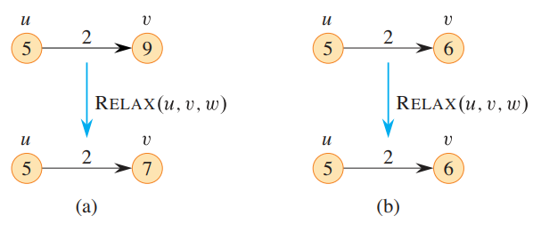
Relaxation
For an edge (u,v) with weight w, relaxation checks if the known shortest path to v can be improved by going through u.

Slide 4
Introduction
Dijkstra's algorithm - is a solution to the single-source shortest path problem in graph theory.
Works on both directed and undirected graphs. However, all edges must have nonnegative weights.
Input: Weighted graph G={E,V} and source vertex v∈V, such that all edge weights are nonnegative
Output: Lengths of shortest paths (or the shortest paths themselves) from a given source vertex v∈V to all other vertices

Slide 5
Applications of Dijkstra's Algorithm
Network Routing Protocols:
Used in OSPF (Open Shortest Path First) and IS-IS routing algorithms to compute the shortest path tree for routing packets.
Mapping and GPS Systems:
Calculating the quickest route between two locations using road network data.
Game Development:
Pathfinding for characters or AI agents (though A* is often preferred for efficiency in certain cases).
Telecommunications:
Optimizing data flow through networks by finding the least-cost path.
Compiler Design:
Used in data-flow analysis and code optimization to calculate the shortest distance in control flow graphs.
Robot Motion Planning:
In robotics, Dijkstra helps robots find the shortest path in a known environment.
Dependency Resolution:
Used in systems like package managers to resolve dependency chains efficiently.

Slide 6
Dijkstra’s Algorithm
Initialize distances from the source to all nodes as infinity, except the source (0).
Use a priority queue (min-heap) to repeatedly select the node with the smallest tentative distance.
Update the distances to neighboring nodes if a shorter path is found.
Repeat until all nodes are visited or the destination is reached.
while Q is not empty:
u := vertex in Q with smallest dist[u]
remove u from Q
for each neighbor v of u:
alt := dist[u] + length(u, v)
if alt < dist[v]:
dist[v] := alt
prev[v] := u
return dist, prev
function Dijkstra(Graph, source):
create a priority queue Q
for each vertex v in Graph:
dist[v] := infinity
prev[v] := undefined
add v to Q
dist[source] := 0

Slide 7
Example: Initialization
Distance(source) = 0
0
∞
Node | Distance | Parent
A | 0
B | ∞
C | ∞
D | ∞
E | ∞
F | ∞
G | ∞
Distance (all vertices but source) = ∞
A
2
B
4
1
3
10
∞
C
2
D
2
E
∞
5
8
∞
4
6
F
1
G
∞
∞
Pick vertex in List with minimum distance.

Slide 8
Example: Update neighbors' distance
0
∞
Node | Distance | Parent
A | 0
B | ∞
C | ∞
D | ∞
E | ∞
F | ∞
G | ∞
A
2
B
4
1
3
10
∞
C
2
D
2
E
∞
∞
5
8
4
6
Distance(B) = 2
F
1
G
Distance(D) = 1
∞
∞

Slide 9
Example: Update neighbors' distance
0
2
Node | Distance | Parent
A | 0
B | 2 | A
C | ∞
D | 1 | A
E | ∞
F | ∞
G | ∞
A
2
B
4
1
3
10
∞
C
2
D
2
E
∞
5
8
1
4
6
Distance(B) = 2
F
1
G
Distance(D) = 1
∞
∞

Slide 10
Example: Pick vertex with minimum distance
0
2
Node | Distance | Parent
A | 0
B | 2 | A
C | ∞
D | 1 | A
E | ∞
F | ∞
G | ∞
A
2
B
4
1
3
10
∞
C
2
D
2
E
∞
5
8
1
4
6
F
1
G
∞
∞
Pick vertex in List with minimum distance, i.e., D

Slide 11
Example: Update neighbors
0
2
Node | Distance | Parent
A | 0
B | 2 | A
C | 3 | D
D | 1 | A
E | 3 | D
F | 9 | D
G | 5 | D
A
2
B
4
1
3
10
3
C
2
D
2
E
3
5
8
1
4
6
Distance(C) = 1 + 2 = 3 Distance(E) = 1 + 2 = 3 Distance(F) = 1 + 8 = 9 Distance(G) = 1 + 4 = 5
F
1
G
9
5

Slide 12
Example: Continued...
Pick vertex in List with minimum distance (B) and update neighbors
0
2
Node | Distance | Parent
A | 0
B | 2 | A
C | 3 | D
D | 1 | A
E | 3 | D
F | 9 | D
G | 5 | D
A
2
B
4
1
3
10
3
C
2
D
2
E
3
Note : distance(D) not updated since D is already known and distance(E) not updated since it is larger than previously computed
5
8
1
4
6
F
1
G
9
5

Slide 13
Example: Continued...
Pick vertex List with minimum distance (E) and update neighbors
0
2
Node | Distance | Parent
A | 0
B | 2 | A
C | 3 | D
D | 1 | A
E | 3 | D
F | 9 | D
G | 5 | D
A
2
B
4
1
3
10
3
C
2
D
2
E
3
5
8
1
4
6
No updating
F
1
G
9
5

Slide 14
Example: Continued...
Pick vertex List with minimum distance (C) and update neighbors
0
2
Node | Distance | Parent
A | 0
B | 2 | A
C | 3 | D
D | 1 | A
E | 3 | D
F | 8 | C
G | 5 | D
A
2
B
4
1
3
10
3
C
2
D
2
E
3
5
8
1
4
6
Distance(F) = 3 + 5 = 8
F
1
G
8
5

Slide 15
Example: Continued...
Pick vertex List with minimum distance (G) and update neighbors
0
2
Node | Distance | Parent
A | 0
B | 2 | A
C | 3 | D
D | 1 | A
E | 3 | D
F | 6 | G
G | 5 | D
A
2
B
4
1
3
10
3
C
2
D
2
E
3
5
8
1
4
6
F
1
G
Previous distance
6
5
Distance(F) = min (8, 5+1) = 6

Slide 16
Example (end)
0
2
Node | Distance | Parent
A | 0
B | 2 | A
C | 3 | D
D | 1 | A
E | 3 | D
F | 6 | G
G | 5 | D
A
2
B
4
1
3
10
3
C
2
D
2
E
3
5
8
1
4
6
F
1
G
6
5
Pick vertex not in S with lowest cost (F) and update neighbors

Slide 17
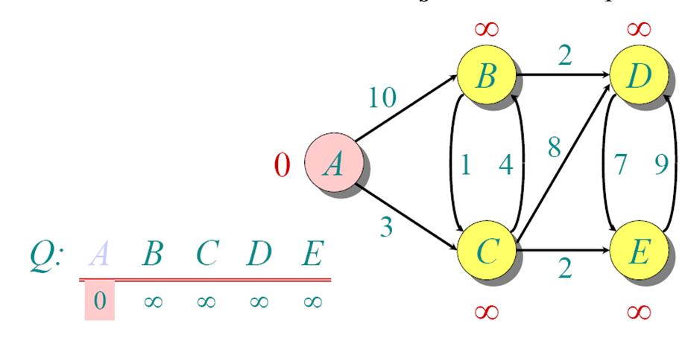
Another Example

Slide 18
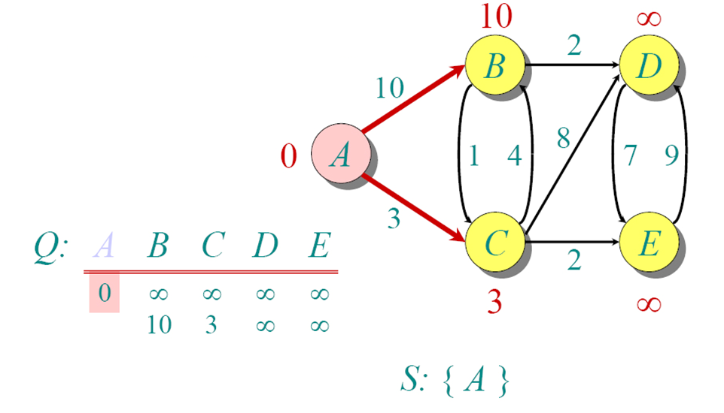
Example: Continued...

Slide 19
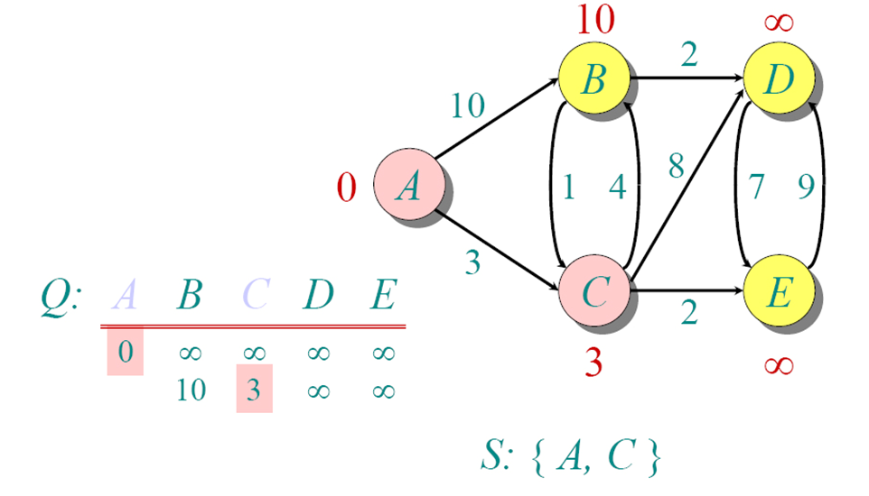
Example: Continued...

Slide 20
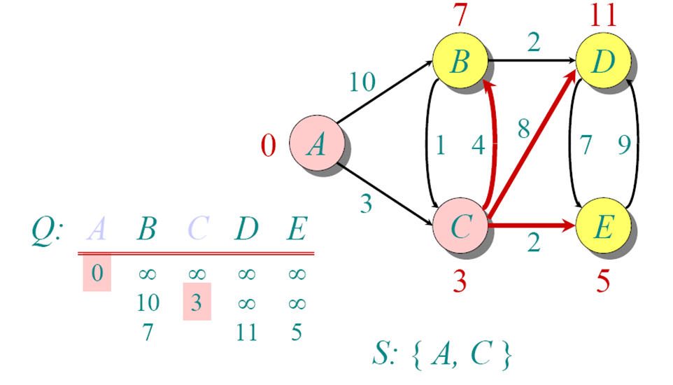
Example: Continued...

Slide 21
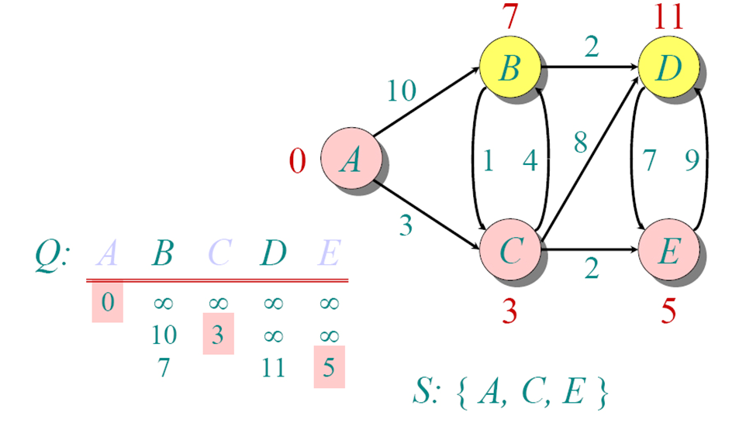
Example: Continued...

Slide 22
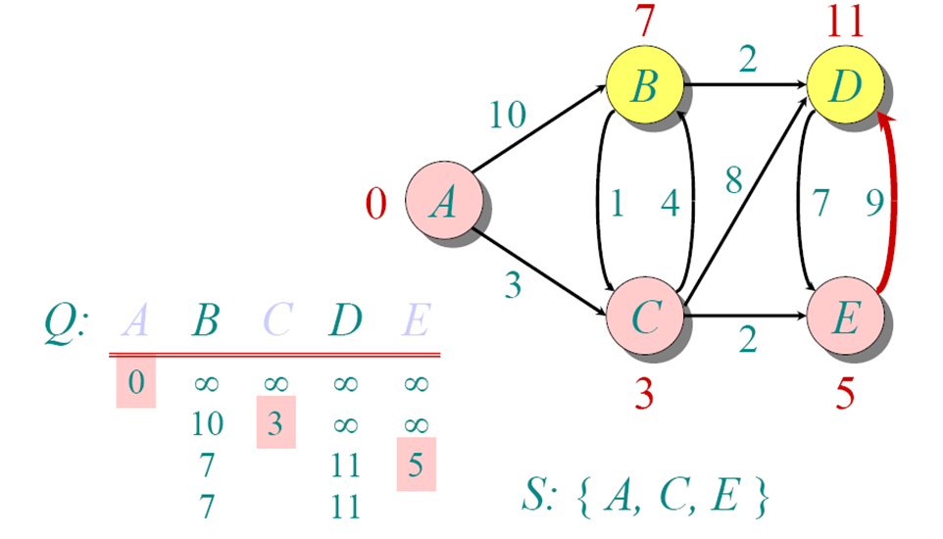
Example: Continued...

Slide 23
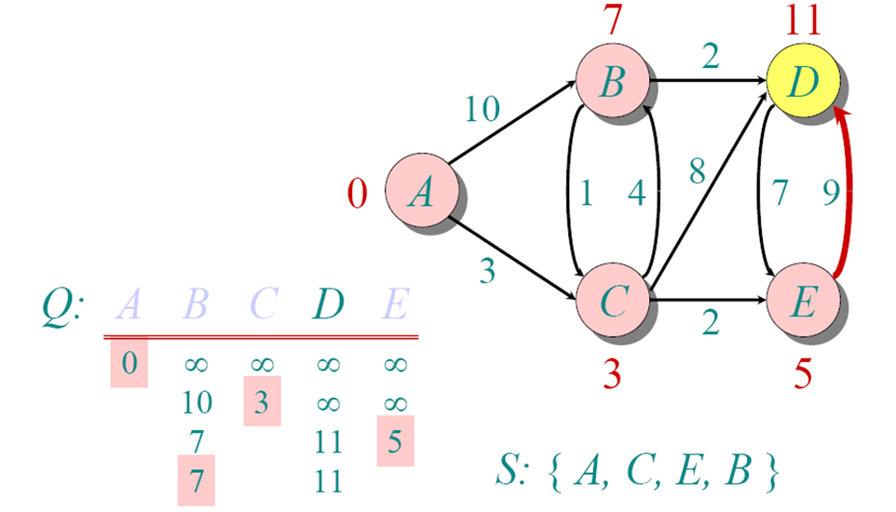
Example: Continued...

Slide 24
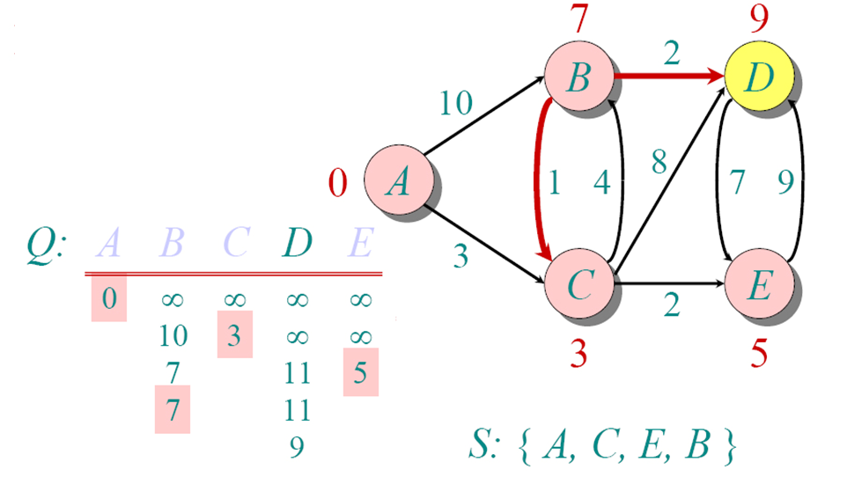
Example: Continued...

Slide 25
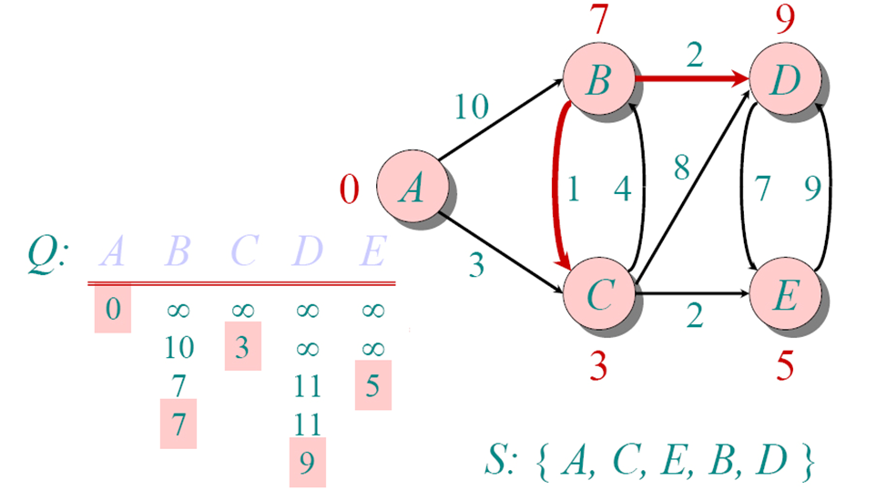
Example: Continued...

Slide 26
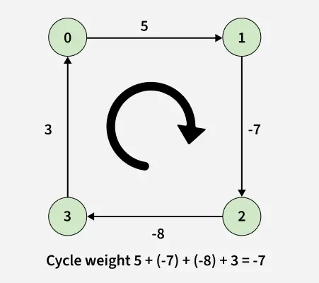
What if Negative Edge/Cycle??
Dijkstra is not suitable when the graph consists of negative edges. The reason is, it doesn’t revisit those nodes which have already been marked as visited. If a shorter path exists through a longer route with negative edges, Dijkstra’s algorithm will fail to handle it.
A negative weight cycle is a cycle in a graph, whose sum of edge weights is negative. If you traverse the cycle, the total weight accumulated would be less than zero.
In the presence of negative weight cycle in the graph, the shortest path doesn’t exist because with each traversal of the cycle shortest path keeps decreasing.

Slide 27
Bellman–Ford Algorithm
Bellman-Ford is a single source shortest path algorithm. It effectively works in the cases of negative edges and is able to detect negative cycles as well. It works on the principle of relaxation of the edge
function BellmanFord(G, source):
for each vertex v in G:
distance[v] = ∞
distance[source] = 0
for i from 1 to |V| - 1:
for each edge (u, v) with weight w in G:
if distance[u] + w < distance[v]:
distance[v] = distance[u] + w
for each edge (u, v) with weight w in G:
if distance[u] + w < distance[v]:
report "Negative-weight cycle detected"
return
return distance
Set the distance to all other nodes as ∞ (infinity).
Set the distance to the source node as 0.
Relax all edges (V - 1) times
Check for negative-weight cycles (optional but important)

Slide 28
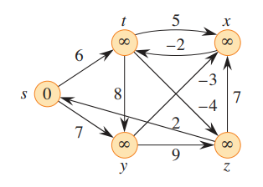
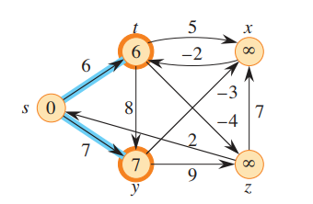
Bellman–Ford Algorithm - Example
First Relaxation

Slide 29
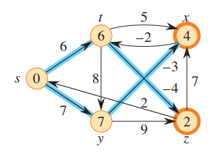
Example Continued…
Second Relaxation

Slide 30
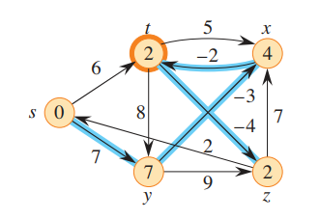
Example Continued…
Third Relaxation

Slide 31
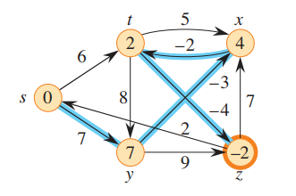
Example Continued…
Fourth Relaxation

Slide 32
Example Continued…
No updates found. Hence, no negative edge cycle present in the graph.
Fifth Relaxation

Slide 33
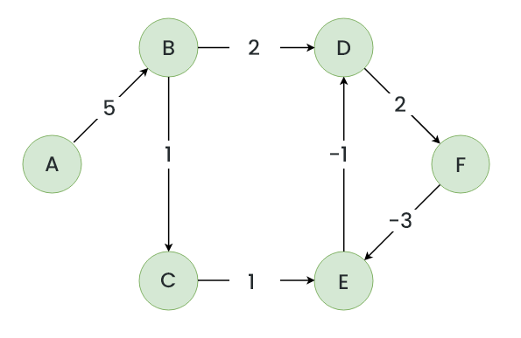
Another Example
Let’s suppose we have a graph which is given below and we want to find whether there exists a negative cycle or not using Bellman-Ford.

Slide 34
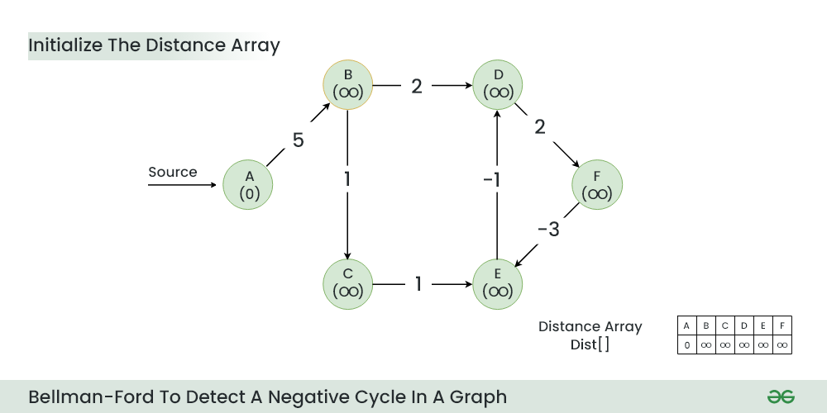
Example Continued…

Slide 35
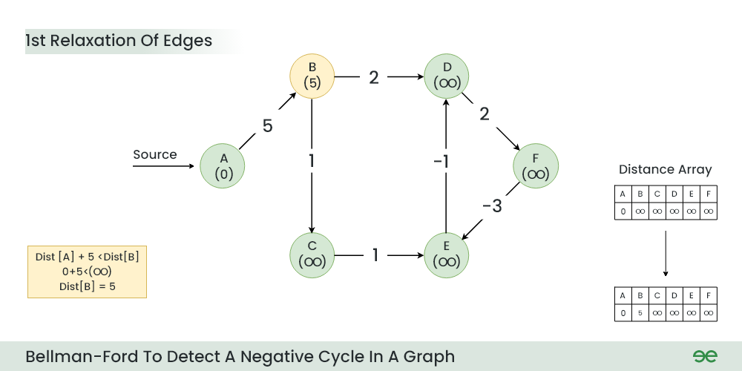
Example Continued…

Slide 36
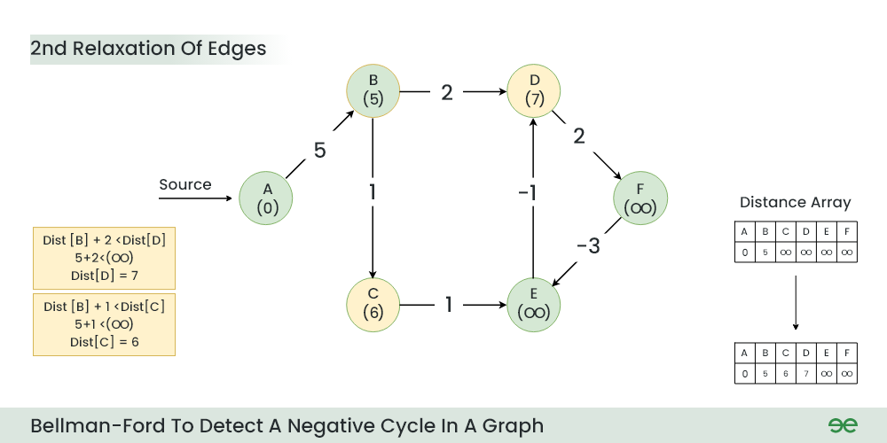
Example Continued…

Slide 37
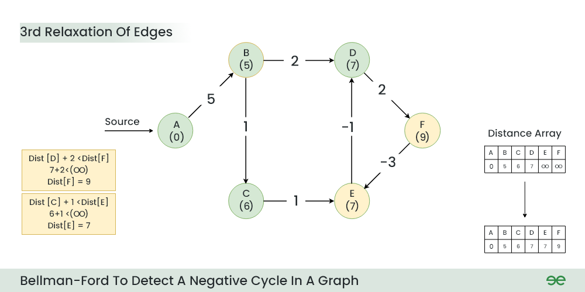
Example Continued…

Slide 38
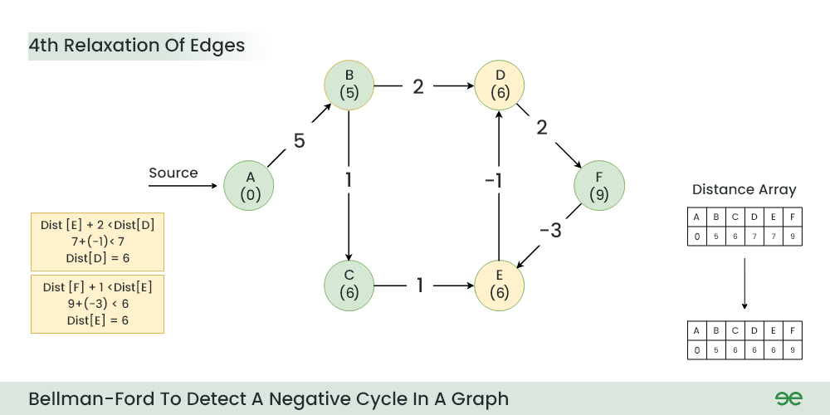
Example Continued…

Slide 39
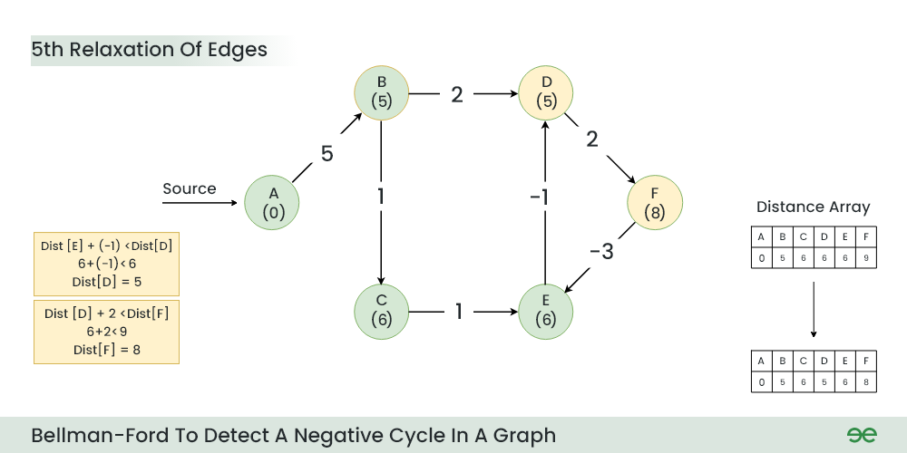
Example Continued…

Slide 40
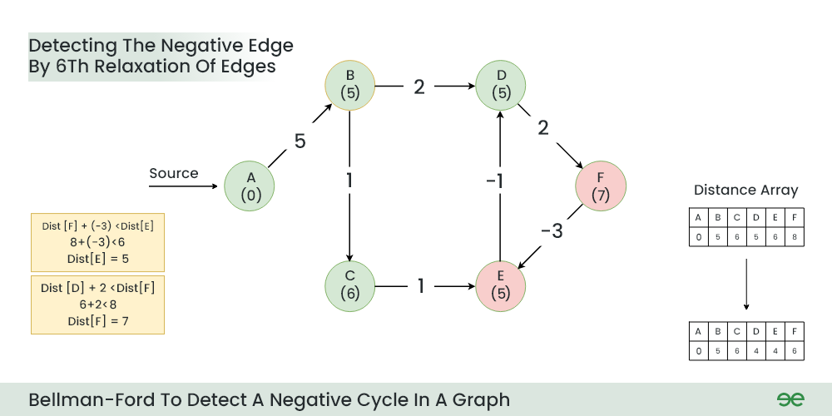
Example Continued…
A negative cycle (D->F->E) exists in the graph.

Slide 41
Thank You

